Slide 1
INVESTMENT CASE STUDY SUBMISSION
Rajeev Agarwal

Slide 2
Investment Strategy for Spark Funds
Business objective: The objective is to identify the best sectors, countries, and a suitable investment type for making investments. The overall strategy is to invest where others are investing, implying that the 'best' sectors and countries are the ones 'where most investors are investing’.
Goals of data analysis:
Investment type analysis: Identify Funding Type that is best suited for Spark Funds’ strategy.
Country analysis: Identify the English speaking countries which have been the most heavily invested in the past.
Sector analysis: Identify the most invested sectors in the selected countries for the chosen funding type.

Slide 3
Problem solving methodology
Flow chart:
Load companies and rounds2 data sets
Data cleaning on companies and rounds2 data frames
Merge the two data frames to create master_frame data frame
Identify the most suitable investment type from master_frame using mean value of the investment amount per round
For the chosen investment type, make data frame top9 with the top nine countries based on the total investment amount per country
Select top three English speak countries from the data frame top9
Load mapping data set and do the data cleaning
Extract primary sector of each category list from the mapping data frame
Merge mapping data frame in companies data frame and remove the rows where primary sector is ‘Blanks’
Convert wide to long data format. Eight main sectors should be converted into a single column ‘main_sector’. Remove the extra rows.
Select master_frame rows where investment amount is between 5 and 15 million
Create three data frames D1, D2 and D3 for the three countries each having total number of investments and average investment amount per main sector for that country
Using D1, D2 and D3 identify top three main sectors of each of the three countries based on the count of investments
Plot graphs and provide the recommendations

Slide 4
Data Cleaning and Understanding
We have taken real investment data from crunchbase.com for this analysis.
Following data sets were used to do the analysis.
Companies – Company details
Rounds2 – Funding round details
Mapping – Sector details
iso-8859-1 encoding was used to load the data files. Non-ascii characters from companies and rounds2 files were removed after loading.
Data was cleaned before analysis to remove null and invalid values.
Rows with Null permalink values were checked and removed from companies and rounds2.
Rows with Null investment amount values were removed.
Rows with Null category_list values were removed from companies and mappings data sets.
Cleaned data sets were merged for the analysis.
Number of unique companies considered for this analysis – 66368
Number of total funding rounds across various funding types considered for these companies - 114949

Slide 5
Funding Type Analysis
Objective: Sparks Funds wants to choose one of the following four funding types- Seed, Angel, Venture and Private Equity Type.
Average Funding Amount per investment round for these four funding types:
Since company wants to invest between 5 to 15 million USD per investment round, the most suitable investment type is – Venture
Funding Type | Average Funding Amount (in Million USD)
Venture | 11.75
Angel | 0.96
Seed | 0.72
Private Equity Type | 73.31

Slide 6
Country Analysis
Objective: Spark Funds wants to invest in English-speaking countries with the highest amount of funding for the chosen investment type (Venture).
Top three English-speaking countries with the highest amounts of total funding for Venture investment type:
, ,llcjldjclkjlkjlkjlkjlkjjjjjjjjjjjjjjjjjjjjjjjjjjjjjjjjjjjjjjjjjjjjjjjjjj
The three selected countries are – USA, Great Britain, and India
Country | Total Funding amount for Venture FT (In Billion USD)
USA | 422.51
GBR | 20.25
IND | 14.39

Slide 7
Sector Analysis
Objective: Spark Funds wants to select the most invested sectors in the chosen three English-speaking countries for the investment type - Venture.
Top three sectors for the countries with the number of investments in each sector:
Assumption: First sector in the category_list column in the companies set is considered as the primary sector of the company
 | USA | Great Britain | India
Top Sector name (no. of investment-wise) | Others (2393) | Others (143) | Others (109)
Second Sector name (no. of investment-wise) | Cleantech / Semiconductors (2297) | Cleantech / Semiconductors (127) | News, Search and Messaging (52)
Third Sector name (no. of investment-wise) | Social, Finance, Analytics, Advertising (1912) | Social, Finance, Analytics, Advertising (98) | Entertainment (33)

Slide 8
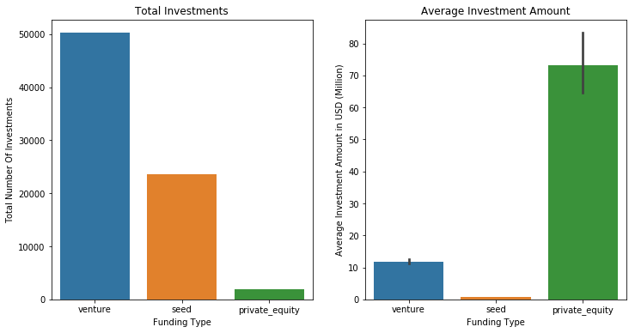
Total Investments and Average Investment Amounts for venture, seed and private equity funding types
Plot1

Slide 9
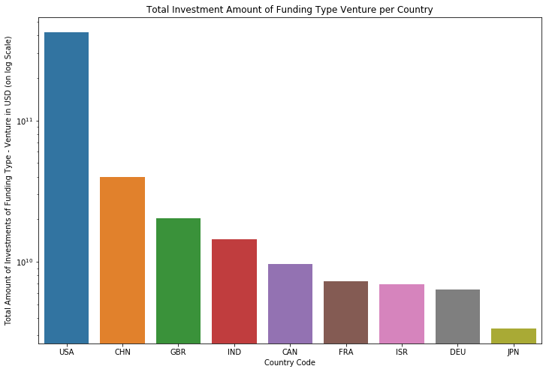
Top nine countries with total investment amount of Venture funding type
Plot2

Slide 10
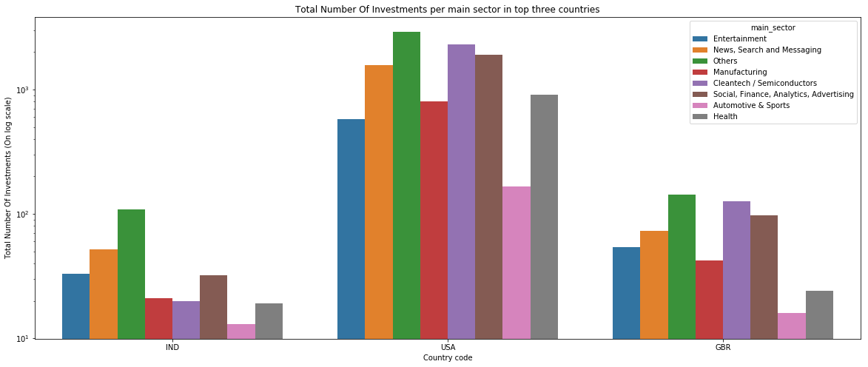
Total number of investments per main sector in the top three countries
Plot3

Slide 11
Investment Recommendations
Most Suitable Investment Type:
Sparks Funds should invest in the Venture funding type as it has the highest total number of investment with average investment amount value USD 11.75 Million.
Top three English speaking countries:
USA, Great Britain and India are three top English speaking countries with highest amount of funding for the chosen investment type (Venture).
Top three Most invested sectors for each of the three countries:
USA – 1. Others, 2. Cleantech / Semiconductors, 3. Social, Finance, Analytics, Advertising
GBR – 1. Others, 2. Cleantech / Semiconductors, 3. Social, Finance, Analytics, Advertising
IND – 1. Others, 2. News, Search and Messaging, 3. Entertainment

